Slide 1
PRETOTYPING
https://www.pretotyping.org/

Slide 2
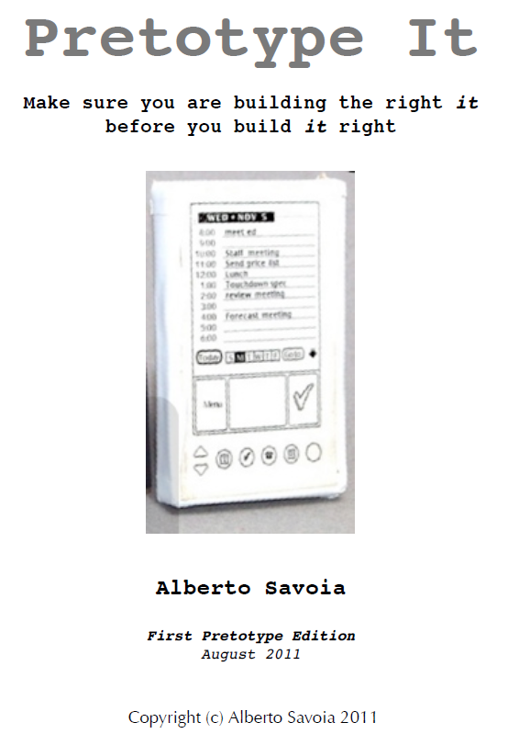
http://www.pretotyping.org/

Slide 3
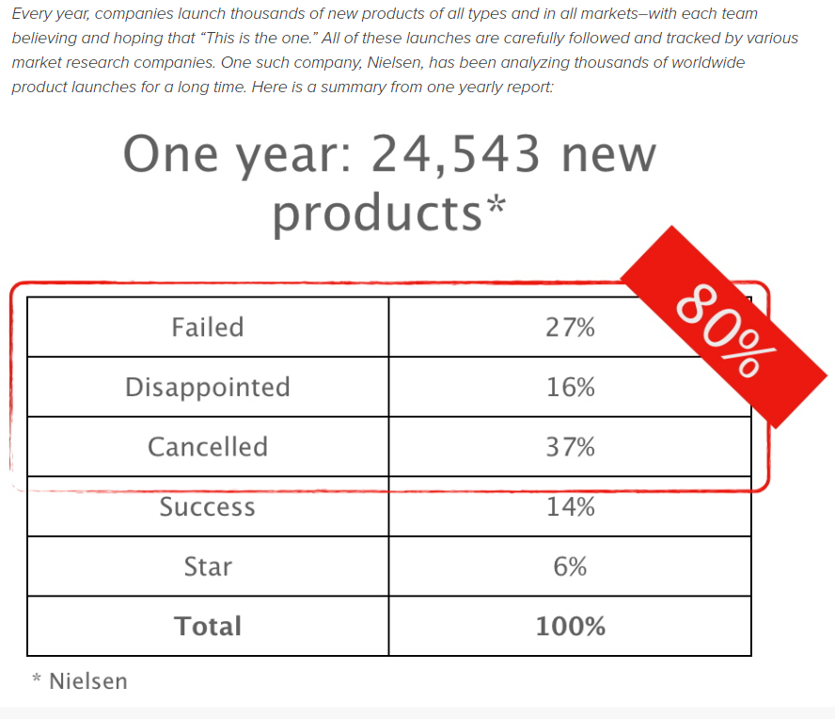
Source: www.pretotyping.org

Slide 4
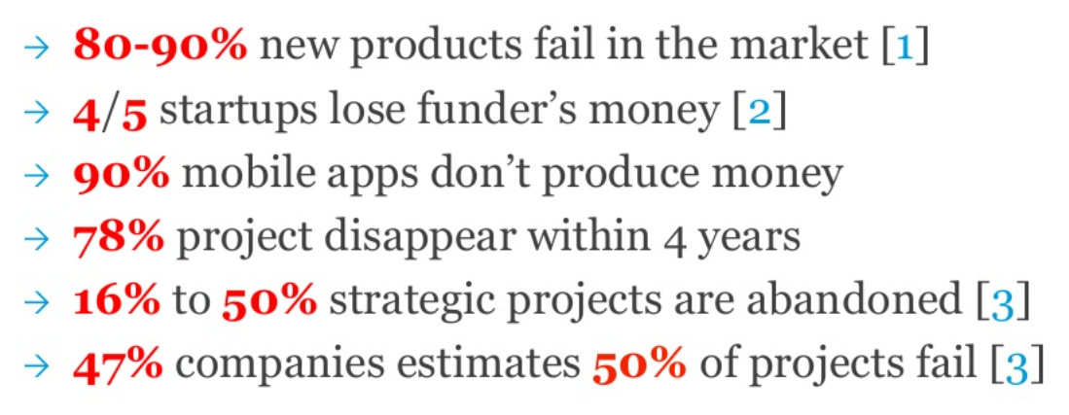
The law of market failure

Slide 5
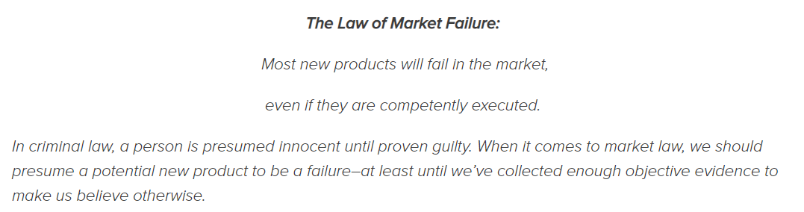
Source: www.pretotyping.org

Slide 6
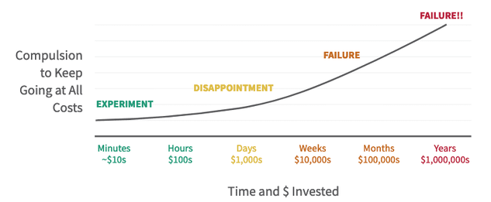
The law of market failure
There is only one way to fight the Law of Market Failure: test the market for your ideas objectively, rigorously, and quickly before you invest to develop them.
Pretotyping provides you with the tools and techniques you need to validate your idea with minimal resources and in a very short time (as little as a few hours.)
Source: www.pretotyping.org

Slide 7
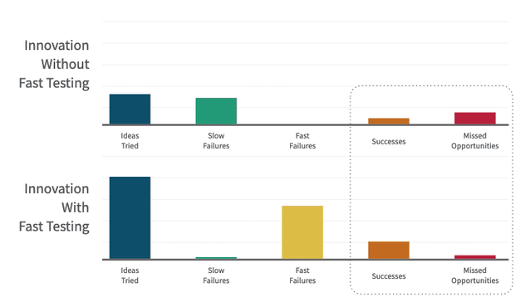
The law of market failure in innvoation
Source: www.pretotyping.org

Slide 8
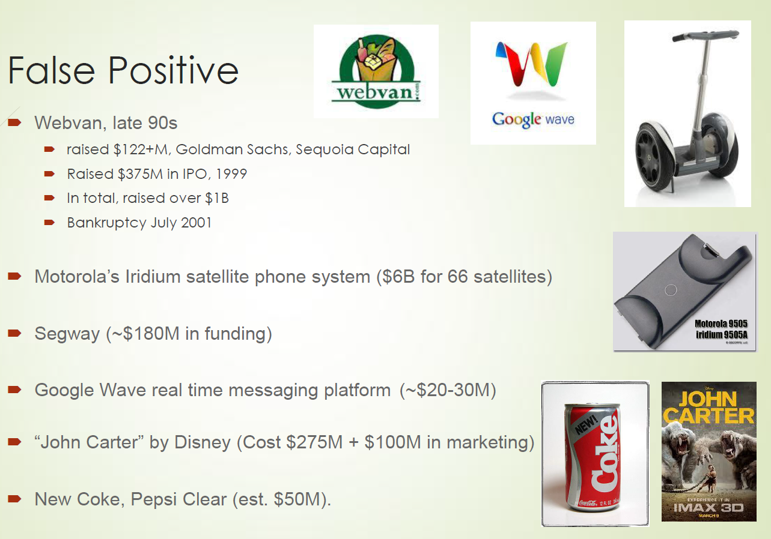
Source: www.pretotyping.org

Slide 9
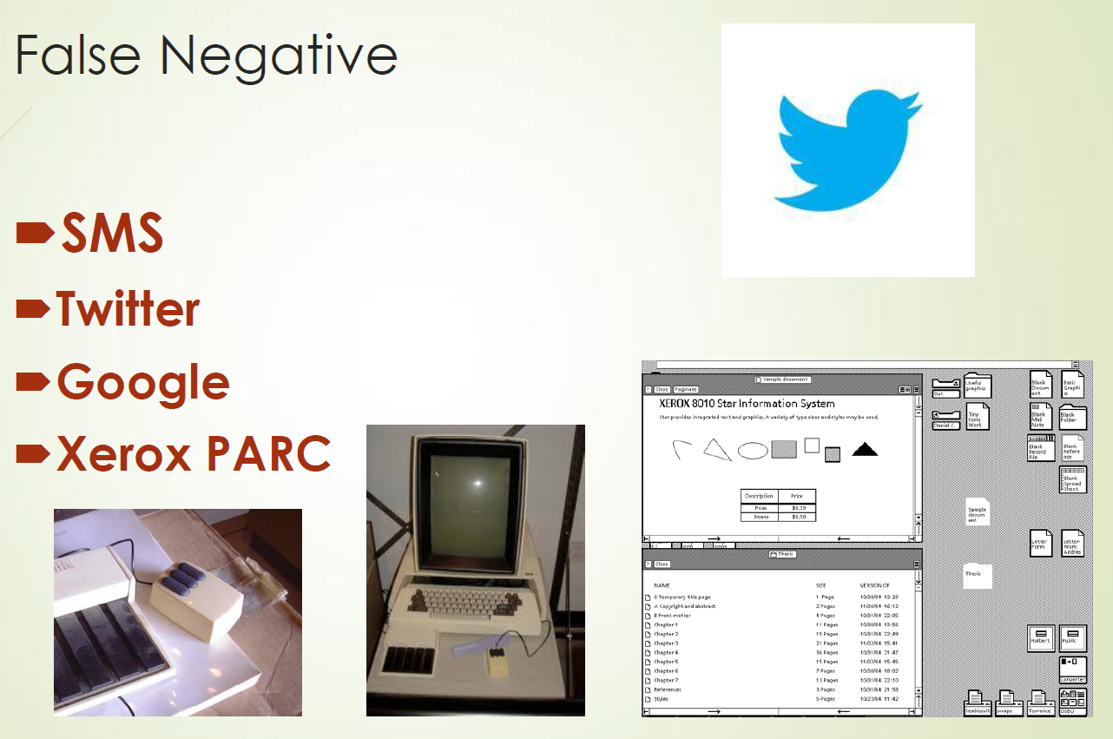
Source: www.pretotyping.org

Slide 10
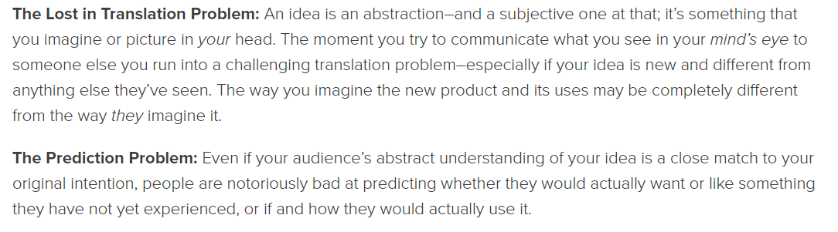
THOUGHTLAND
Source: www.pretotyping.org

Slide 11
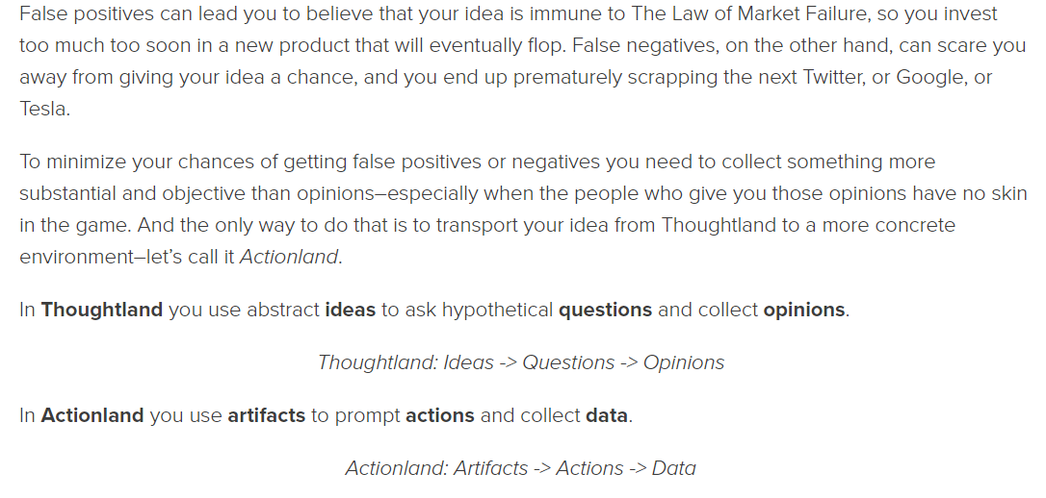
THOUGHTS WITHOUT DATA ARE JUST OPINIONS
Source: www.pretotyping.org

Slide 12
The Pretotyping Manifesto
innovators beat ideas
pretotypes beat productypes
building beats talking
simplicity beats features
now beats later
commitment beats committees
data beats opinions
don’t finish what you’ve started failure is an option scarcity bring clarity the more the messier reinvent the wheel play with fire
Source: www.pretotyping.org

Slide 13
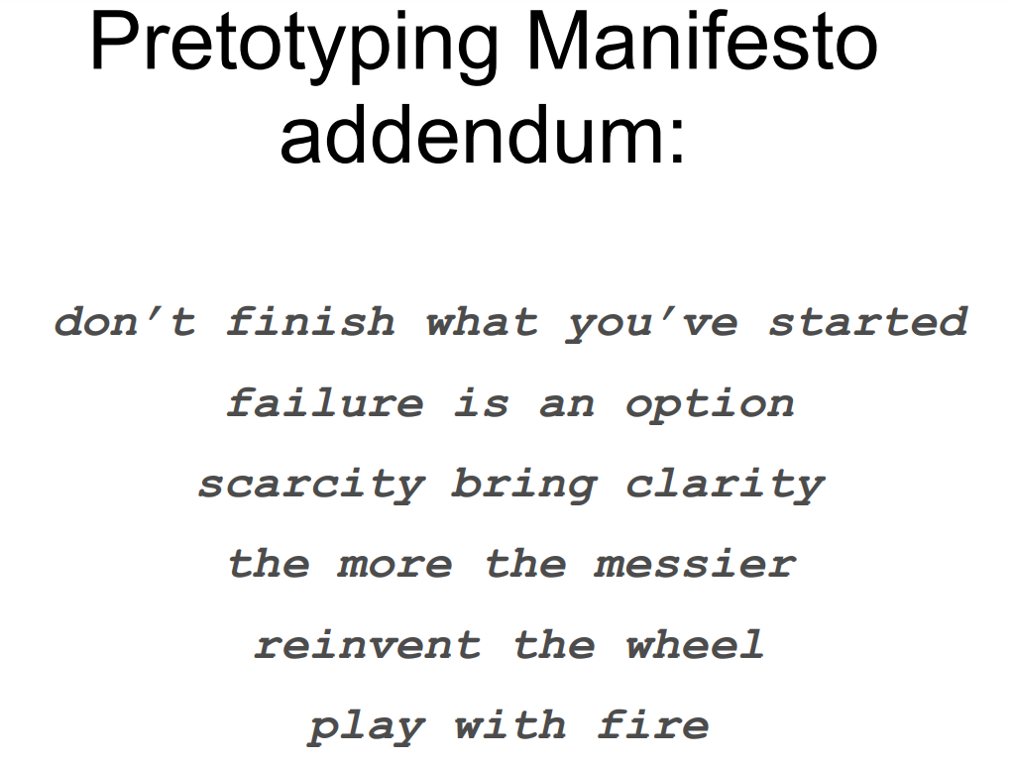
Source: www.pretotyping.org

Slide 14
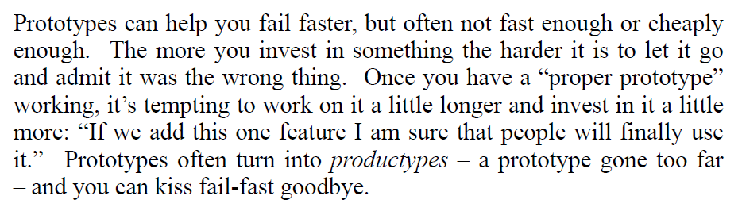
Pretotype
Source: www.pretotyping.org

Slide 15
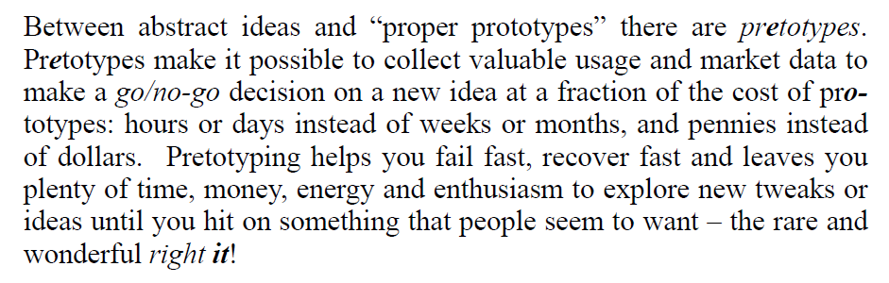
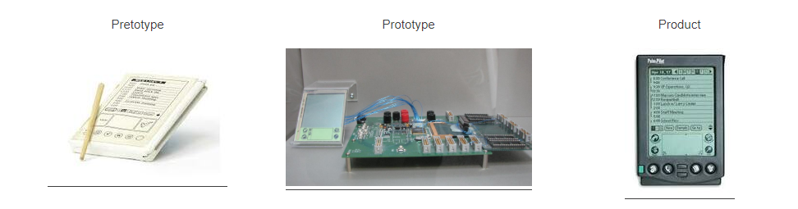
Pretotype
Source: www.pretotyping.org

Slide 16
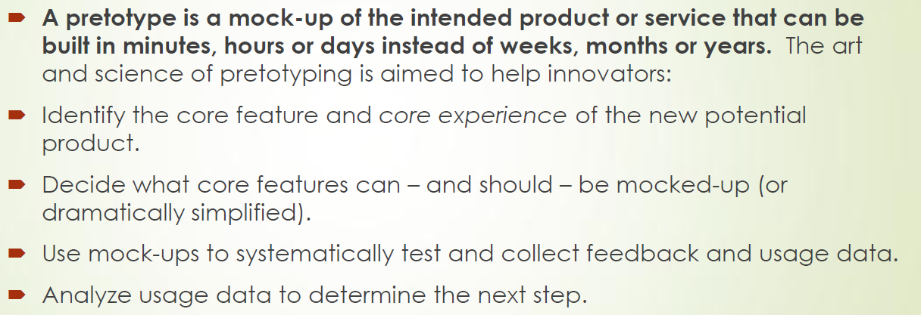
Pretotype
Source: www.pretotyping.org

Slide 17

The Seven Pillars of PRETOTYPING
Obey the Law of Market Failure.
Make sure you are building The Right It.
Don't get lost in Thoughtland.
Trust only in Your Own DAta (YODA).
Pretotype It.
Say it with numbers.
Think global, test local.
Source: www.pretotyping.org

Slide 18
PRETOTYPING FLOW
Step 1: Isolate the Key Assumption: What is the one assumption about your idea that, if false, means it's definitely not the right it?
Step 2: Choose a Type of Pretotype: What type of pretotype will let you to isolate and test your key assumption?
Step 3: Make a Market Engagement Hypothesis: How many (and what kind of) people will do what with your pretotype? Your hypothesis can be as simple as: X% of Y will do Z -->A solid hypothesis takes the guesswork and opinion out of testing. https://www.youtube.com/watch?v=4sZMHAMN0DQ&ab_channel=TheRightIt%E2%80%94VideolessonsbyAlbertoSavoia
Step 4: Test Your Pretotype: Now put your pretotype into the real world, and see how people interact with it. Start small — one place, one time.
Step 5:Learn, Refine, Hypozoom: Evaluate your results. Refine your pretotype with your new data. If you hypothesis held, decide what other situations you should test your pretotype in to get a complete picture (what we call "hypozooming"). https://www.albertosavoia.com/uploads/1/4/0/9/14099067/hypozooming_video.pdf https://www.youtube.com/watch?v=bKfBbYsJlZc&ab_channel=TheRightIt%E2%80%94VideolessonsbyAlbertoSavoia
Source: www.pretotyping.org

Slide 19
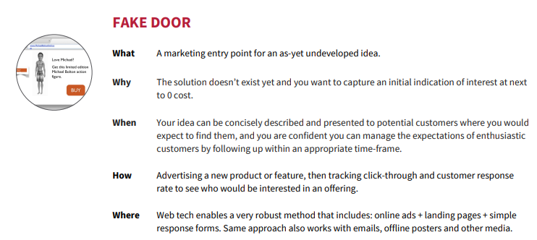
FAKE DOOR
the Fake Door can be used to advertise a service that is not ready yet and measure interest from users, e.g. a new process to renew a license, a new expert system to consolidate social services, etc.
https://www.nesta.org.uk/blog/development-and-testing-for-public-labs-fake-it-before-you-make-it/

Slide 20
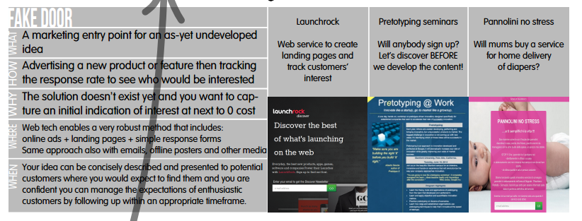
FAKE DOOR
Source: www.pretotyping.org

Slide 21
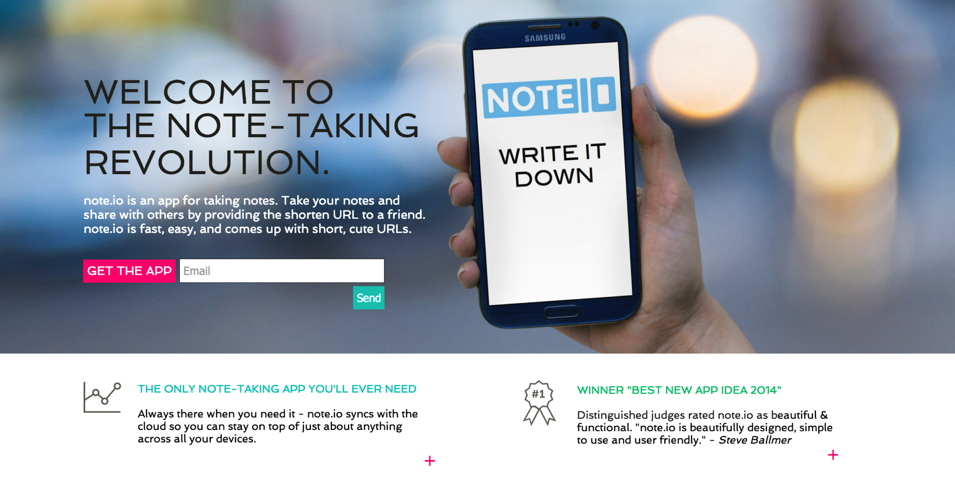
https://hackernoon.com/fake-door-the-mvp-before-the-mvp-61197ed264a3

Slide 22
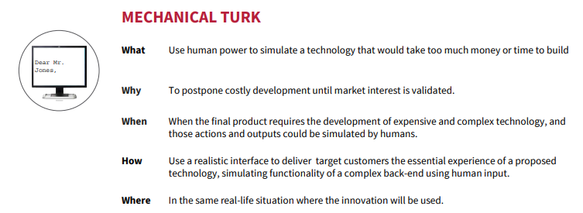
Algorithmic-based solutions are needed to reach scale while keeping the cost low. But before finding the right "advisor" to build, a Mechanical Turk approach can be used to experiment, where human experts can hide behind an online form or a SMS-based application.
https://www.nesta.org.uk/blog/development-and-testing-for-public-labs-fake-it-before-you-make-it/

Slide 23
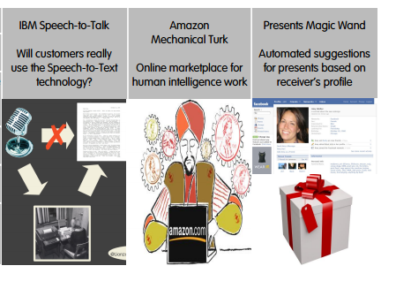
MECHANICAL TURK
Source: www.pretotyping.org

Slide 24
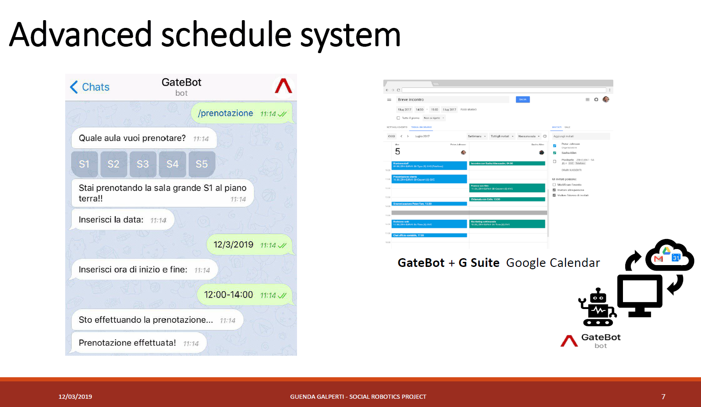

Slide 25
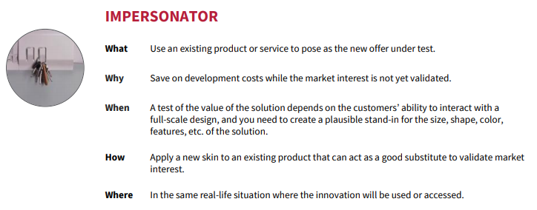
In the context of public labs, this could mean revamping an existing service by providing a different front-end on top of an existing API.
https://www.nesta.org.uk/blog/development-and-testing-for-public-labs-fake-it-before-you-make-it/
Video “IKEA” Design studio Upwell hacks IKEA... on Vimeo

Slide 26
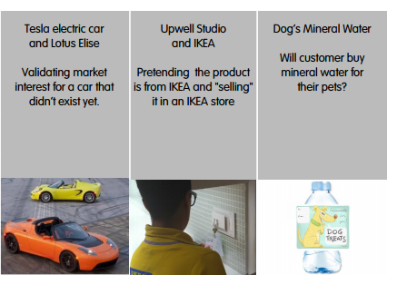
IMPERSONATOR
https://vimeo.com/79313674
Source: www.pretotyping.org

Slide 27
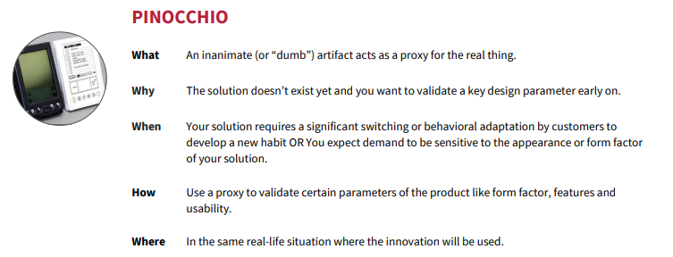
A Pinocchio pretotype is one in which a fake artifact acts as a proxy for the real thing. The most famous example is the wood model of the Palm Pilot mentioned above.
Pinocchio pretotypes are the perfect conduit for role play design to encourage people to test your product or service, but also to explore other ways that the "it" you are building is tailored to their needs.

Slide 28
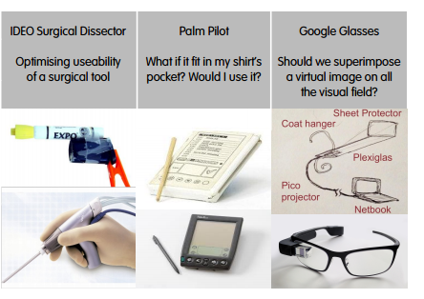
PINOCCHIO
Source: www.pretotyping.org

Slide 29
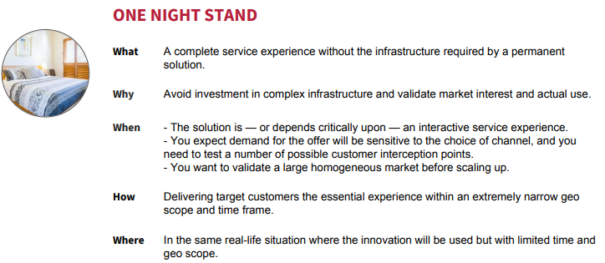
The goal here is to reduce cost or to target a well-known population. In the spirit of failing fast, if the One Night Stand pretotype applied to a friendly region and receptive population does not succeed, then you know that you are probably building the wrong "it".
https://www.nesta.org.uk/blog/development-and-testing-for-public-labs-fake-it-before-you-make-it/

Slide 30
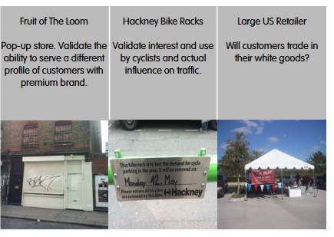
ONE NIGHT STAND
Source: www.pretotyping.org

Slide 31
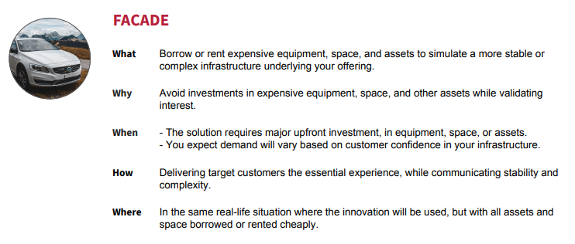
https://www.youtube.com/watch?v=9ko6oFb-jQY

Slide 32
NEXT STEP… PRODUCTION?

Slide 33
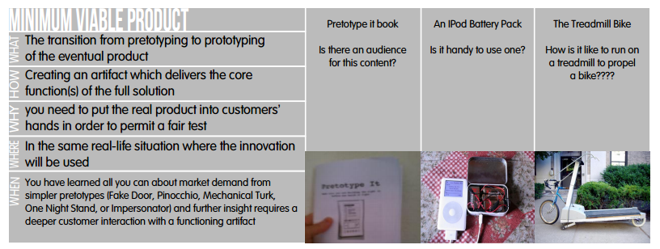
MINIMUM VIABLE PRODUCT
Source: www.pretotyping.org

Slide 34
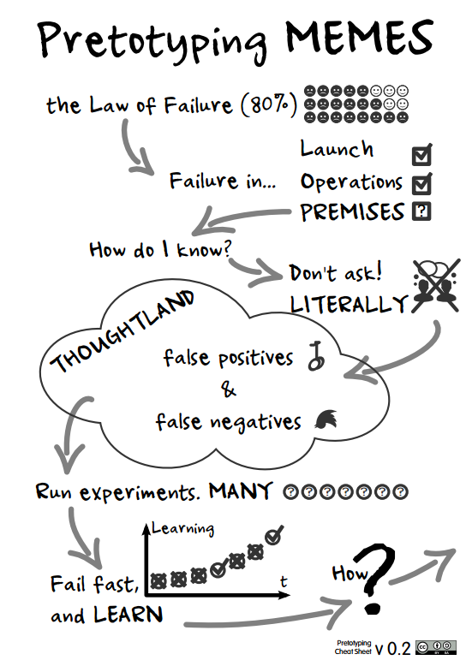
Source: www.pretotyping.org

Slide 35
Pretotyping tools
WebsiteWeebly.com: Particularly useful for fake door pretotypes to test using Google/Facebook ads.
Omnigraffle: Shares across multiple pages and spits out clickable
Appery - free, cloud-based app platform - http://appery.io
UX prototype https://www.figma.com/
https://careerfoundry.com/en/blog/ux-design/prototyping-tools/
And even more drag and drop app builders:
https://codiqa.com/
http://www.kinvey.com/
http://cloudbase.io/
http://mobile.conduit.com/
http://mobileroadie.com/
http://www.theappbuilder.com/
Marketplace builder https://www.shopify.com/

Slide 36
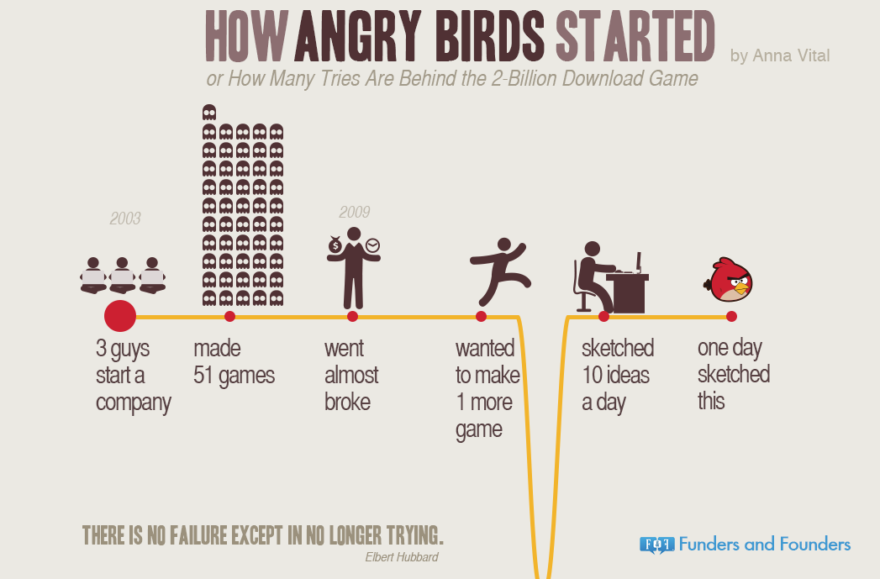
https://blog.adioma.com/how-angry-birds-started-infographic/#:~:text=The%20startup%20behind%20the%20game,are%20launching%20their%2051st%20game.

Slide 37
Alberto Savoia Pretotyping Lecture @ Stanford
https://www.youtube.com/watch?v=3sUozPcH4fY&feature=emb_logo

Slide 38
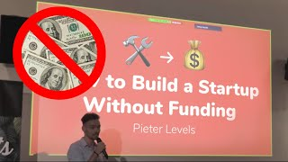
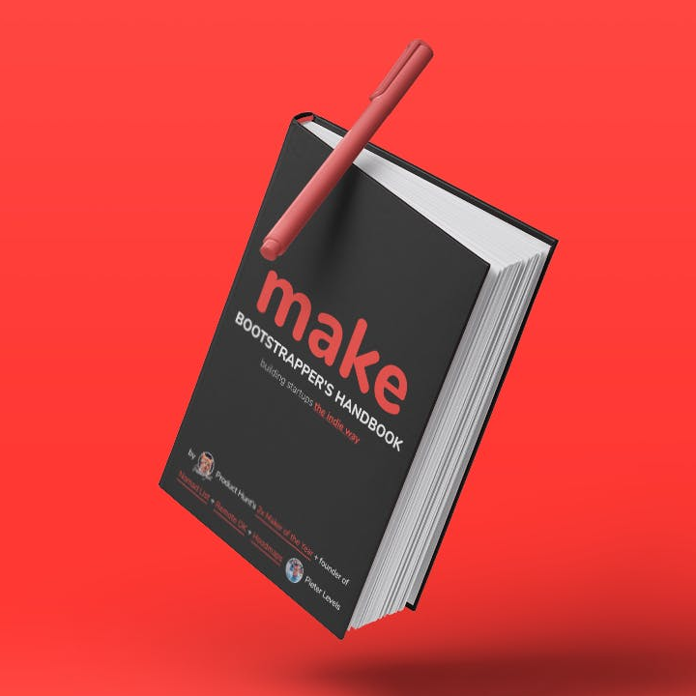
Founder Mode

